Slide 1
LINUX

Slide 2
History of Linux
Linux is an Operating System Created in Early 1990s by a Finnish Software Engg. Linus Torvalds
He still as a student at University of Helsinki started developing Linux similar to MiniX(A Unix O.S.)
American Software Developer Richard Stallman and FSF(Free Software Foundation) made efforts to create Open Source Unix like O.S. called GNU(GNU’s not Unix)
Although Linux is not user-friendly like windows, MAC. It is efficient and reliable system that rarely crashes
Because it is open-source and thus modifiable for different uses, Linux is popular for systems as diverse as cellular telephones and super computers.

Slide 3
Features of Linux
Open source - Linux source code is freely available and it is community based development project. Multiple teams work in collaboration to enhance the capability of Linux operating system and it is continuously evolving
Portable - Portability means software can works on different types of hardware in same way. Linux kernel and application programs supports their installation on any kind of hardware platform.
Reliable - Consistently good in performance
Multiuser - Multiple users can access the same system resources like memory, hard disk, etc. But they have to use different terminals to operate.
Multitasking - More than one function can be performed simultaneously
Security - Linux provides user security using authentication features like password protection/ controlled access to specific files/ encryption of data.

Slide 4
File Hierarchy
Filesystem hierarchy standard describes directory structure and its content in Unix and Unix like operating system. It explains where files and directories should be located and what it should contain.
The Root Directory - All the directories in the Linux system comes under the root directory which is represented by a forward slash (/). Everything in your system can be found under this root directory even if they are stored in different virtual or physical devices.
Directory type | Types of files stored
Binary directories | Contains binary or compiled source code files, eg, /bin, /sbin, etc.
Configuration directories | Contains configuration files of the system, eg, /etc, /boot.
Data directories | Stores data files, eg, /home, /root, etc.
Memory directories | Stores device files which doesn't take up actual hard disk space, eg, /dev, /proc, /sys.
Usr (Unix System Resources) | Contains sharable, read only data, eg, /usr/bin, /usr/lib, etc.
var (variable directory) | Contains larger size data, eg, /var/log, /var/cache, etc.
Non-standard directories | Directories which do not come under standard FHS, eg, lost+found, /run, etc.

Slide 5
RHEL Versions
To know more about RHEL Versions
https://access.redhat.com/articles/3078

Slide 6
Architecture of Linux
Consists of all Peripheral Devices(RAM/HDD/CPU)
Hardware

Slide 7
Architecture of Linux
Kernel – Core component of O.S. Interacts
directly with Hardware, provides low level
services to upper layer components
Kernel
Hardware

Slide 8
Architecture of Linux
Shell
Shell – An interface to kernel, Hiding complexity of
Kernel’s Function from users. The Shell takes
Commands from user and executes kernel functions
Kernel
Hardware

Slide 9
Architecture of Linux
Utilities (Commands)
Utilities – Utility programs that provide the
user most of functionalities of an O.S.
Shell
Kernel
Hardware

Slide 10
Installation
Reference Link:
https://www.tecmint.com/redhat-enterprise-linux-7-installation/

Slide 11
Boot Process
BIOS Performs POST
Any devices connected, it checks H/W working properly or not
BIOS reads MBR
Performs system integrity check, it searches, loads and execute the boot loader program. Once the bootloader program is detected and loaded into the memory BIOS gives the control to MBR. In simple term BIOS loads and execute MBR boot loader
MBR
Checks boot files
GRUB
It is multi boot loader which displays a splash screen, waits for few second if you don't enter anything it loads the default kernel as specified in /etc/grub.conf
Kernel
Once the control is given to kernel which is central part of OS act like a mediator between Software and Hardware. Kernel once loaded into RAM it always resides in RAM. Until the machine is shutdown. Once kernel starts operation the first thing it do is executing INIT Process
INIT
Initilization process /etc/inittab to decide linux runlevel
Run Level
When the system is booting up you might see various system starting. Those are runlevel programs. Executed from run level directory /etc/rc.d/
Run Level in Linux:
0 => Shutdown
1 => Single User Mode
2 => Multiuser without NFS
3 => Multiuser
4 => No use
5 => Full Graphical
6 => Reboot

Slide 12
Basic Commands
Basic Commands
touch – To create/touch single file {touch abc}
ls – To list the contents of Directory {ls}
ls –ltr – To list contents in Directory with Details {ls –ltr}
history – To view previously used commands {history}
vi / vim – To Edit the file {vi filename}
cat – To view the contents in file, Other cat commands {cat filename}
cat > file1 – Overwrite file using cat command
cat >> file1 – Append file using cat command
cat file1 file2 – To combine 2 files
mkdir – To create Directory {mkdir directory_name}
mkdir -p course/{test1,test2} – To create parent directory and then the sub-directory
rmdir – To remove Directory {rmdir directory_name}
cd – To change directory {cd directory_name or cd ..} cd .. To go one step backward
mv – To move file/directory from one place to other {mv file1 /tmp/}
rm – To remove file/directory from one place to other {rm –f filename or rm –rf directoryname}
cp - To copy file/directory from one place to other {cp file1 /tmp/file2}
pwd - To show present working directory
Administration Commands
df –h – To view the disk usage
top – To view the resource utilization
free –m – To view the memory usage
ps –elf – To view the processes running
ifconfig – To list IP Addresses
route – To list routes
netstat –nr – To list routes
ping – Used to check the destination communicating or not {ping IP_address}
telnet <ip_addr> <port> - checking destination ip address with port
man – To display manual of particular command {man cat}
--help – To get help/options for commands {cat –help or ls –help}

Slide 13
Insert Mode
i => insert
o => insert in next line
O => insert above line
Command Mode
G => Go to last line
gg => Go to first line
yy => copy line
p => paste line
dd => delete line
nyy => copy 3 lines(n=number of line)
ndd => Delete number of lines (n=number)
vi / vim
Extended or Colon Mode
:w => To write
:q => To quit
! => Forceful write or quit

Slide 14
Explaining ls –ltr output
(root@RHEL7)# ls -ltr
-rwxrw-r-- 1 root root 2048 Jan 13 07:11 afile
file permissions (-rwxrw-r--),
number of (hard) links (1),
owner name (root),
owner group (root),
file size in bytes (2048),
time of last modification (Jan 13 07:11), and
file/directory name (afile)
first character is most often -, l or d. d indicates a directory, a - represents a file, l is a symlink (or soft link) and other letters are used for other types of special files
three sets of characters, three times, indicating permissions for owner, group and other:
r = readable
w = writable
x = executable (for files) or accessible (for directories)
this may be followed by some other character of there are extended permissions, like e.g. Linux ACL that are marked with a +.
In your example -rwxrw-r--, this means the line displayed is:
a regular file (displayed as -)
readable, writable and executable by owner (rwx)
readable, writable, but not executable by group (rw-)
readable but not writable or executable by other (r--)
The number of hard links means the number of names the inode has, i.e. links created with ln without the -s option.

Slide 15
Links
A link in UNIX is a pointer to a file. Creating links is a kind of shortcuts to access a file.
There are two types of links :
Soft Link or Symbolic links
A soft link is similar to the file shortcut feature which is used in Windows Operating systems. Each soft linked file contains a separate Inode value that points to the original file.
ls -l command shows all links with first column value l
Soft Link contains the path for original file and not the contents.
Removing soft link doesn’t affect anything but removing original file, the link becomes “dangling” link which points to nonexistent file.
Command to create a Soft link is: Syntax: ln –s original_path_filename link_name
Ex: ln –s /tmp/h1/head/something/paper paper
Cont….

Slide 16
Links
Cont…
2. Hard Links
Each hard linked file is assigned the same Inode value as the original, therefore they reference the same physical file location. Hard links more flexible and remain linked even if the original or linked files are moved throughout the file system, although hard links are unable to cross different file systems.
We cannot create a hard link for a directory to avoid recursive loops.
If original file is removed then the link will still show the content of the file.
To make it short : Hard link is similar to copy command
Command to create a Soft link is: Syntax: ln original_path_filename link_name
Ex: ln /tmp/h1/head/something/paper paper

Slide 17
CHMOD
chmod command is used to change the Permission of a file/directory. The name is an abbreviation of CHange MODe.
-rwxr-xr--
The first character shows file/directory/link
The 2nd,3rd & 4th character (rwx) is for user permission
The 5th, 6th & 7th character (r-x) is for group permission
The 8th, 9th & 10th character (r--) is the permission for others
The three actions available on Linux systems are:
* read (the ability to open and view the contents of the file)
* write (the ability to open and modify the contents of a file)
* execute (the ability to run the file as an executable program)
Cont…

Slide 18
In CHMOD there are 2 Methods:
1st Numeric Method
which is a string of three digits that each represent user, group, and others permission. Each digit can range from 0 to 7, and each digit's value is obtained by summing the class's permissions:
0 means no permissions allowed.
read / r value is 4
write / w value is 2
execute / x value is 1
ex:
chmod 777 filename
chmod 777 directory_name
2nd Symbolic Method
1. chmod u=rwx,g=rwx,o=rwx filename
To give full permission
2. chmod o+w filename
Already for others read access there, Adding write access also

Slide 19
CHOWN
chown command is used to change the file owner and group.
Ex: Before running chown command
-rw-r--r--. 1 root root 0 Feb 10 16:53 abc1
Now in the example above the owner and group owner of file abc1 is root
Syntax:
chown user:group filename
Command Example:
chown divakar:divakar abc1
Ex: After running chown command
-rw-r--r--. 1 divakar divakar 0 Feb 10 16:53 abc1

Slide 20
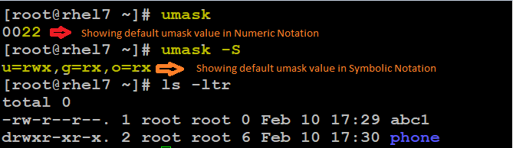
UMASK
Umask, or the user file-creation mode, is a Linux command that is used to assign the default file permission sets for newly created folders and files
The term mask references the grouping of the permission bits, each of which defines how its corresponding permission is set for newly created files. The bits in the mask may be changed by invoking the umask command.
When using the term Umask, we are referring to one of the following two meanings:
The user file creation mode mask that is used to configure the default permissions for newly created files and directories
The command “umask” which is used to set the umask value
Default umask value for root user is 0022 and umask value for normal/other user is 0002
In the above image the umask value is 0022, So the default permission for files is u=rw, g=r and o=r and default permission for directories is u=rwx, g=rx and o=rx
Cont…

Slide 21
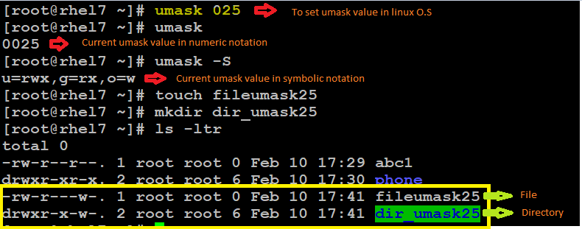
UMASK
Cont…
In the above image, we are setting umask value as 0025. Which results the file permission with
For user=rw, group=r and others=w
The permission for Directory is
For user=rwx, group=rx and others=w

Slide 22
UMASK
Reference Links:
https://www.liquidweb.com/kb/what-is-umask-and-how-to-use-it-effectively/
https://www.cyberciti.biz/tips/understanding-linux-unix-umask-value-usage.html
Along with reference links, below I’ve attached excel object, which as umask table for practice

Slide 23
User Management
User Administration
While creating users below 4 paths are getting affected
1st /etc/passwd => In this file user data will be added like userid, groupid, user homedirectory etc…
To know fields of /etc/passwd file. Go to link : https://www.cyberciti.biz/faq/understanding-etcpasswd-file-format/
2nd /etc/shadow => In this file user information like encrypted password, last password changed, min & max days to change password etc…
To know fields of /etc/shadow file. Go to link : https://www.cyberciti.biz/faq/understanding-etcshadow-file/
3rd cat /etc/default/useradd => From this file it fetches data, where the user home directory, what shell etc.. To be created
4th cat /etc/login.defs => From this file it fetches what is the min & may password expiration, before how many days the warning message for password change to give etc…
Cont…

Slide 24
User Management
To create user:
Syntax: useradd username
Command: useradd dicaprio
Creating users with options
Command: useradd –u 1100 -c “Admin” –d /test –s /bin/sh angelina
To Modify User:
Syntax: usermod [options] [username]
Command: usermod –u 1101 –c “Admin” Daniel
To Delete User:
Syntax: userdel username
Command: userdel dicaprio => To remove users only, still user data exists
Command: userdel –r angelina => To remove users with user data

Slide 25
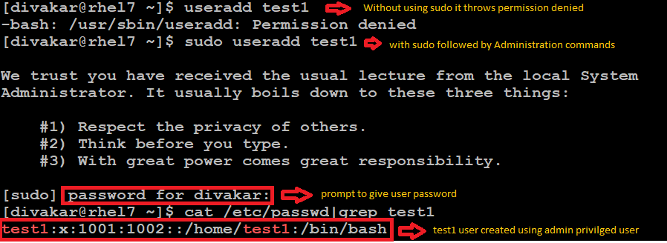
User Management
Adding user to give Admin Privileges:
Edit file /etc/sudoers or run command “visudo” and add line as below
Syntax: username ALL=(ALL) ALL
Ex: daniel ALL=(ALL) ALL
2. Save and Exit the file
Now user Daniel as Admin Privileges.
But to run Admin privileged commands, user has to add “sudo” before running any admin commands
For ex:
Login as a user Daniel, and create user

Slide 26
Group Management
Group Administration
While creating groups below 2 paths are getting affected
1st /etc/group => In this file group information will be added like groupid etc…
To know fields of /etc/group file. Go to link : https://www.cyberciti.biz/faq/understanding-etcgroup-file/
2nd /etc/gshadow => In this file group information like encrypted password etc…
To know fields of /etc/gshadow file. Go to link : https://www.linuxgurus.in/linux-etc-gshadow-file/
Cont…

Slide 27
Group Management
To Create Group:
Syntax: groupadd groupname
Command: groupadd development
To Add User to Group:
Syntax: usermod -g [username]
Command: usermod –g development Daniel =>This command changes user primary group to development
Command: usermod –G development Daniel =>This command adds user as secondary group to development
To Delete Group:
Syntax: groupdel groupname
Command: groupdel development =>Note: Before deleting group, make sure no users are primary part of the group

Slide 28
Special Permissions - setuid
This bit is present for files which have executable permissions
To locate the setuid, look for “s” instead of “x” in the executable bit of the file permission
Example of an executable with setuid permission is /usr/bin/passwd, /usr/bin/xorg etc…
Values for Special Permissions:
For SETUID value is 4
For SETGID value is 2
For Sticky bit value is 1
How to set setuid for file?
chmod 4755 filename
chmod u+s filename

Slide 29
Special Permissions - setgid
The setgid affects both files and directories
To locate the setgid, look for “s” in group section of file permission
Values for Special Permissions:
For SETUID value is 4
For SETGID value is 2
For Sticky bit value is 1
How to set setgid for file?
chmod 2755 filename
chmod g+s filename

Slide 30
Special Permissions - Sticky bit
When a directory has the sticky bit set, it’s files can be deleted or renamed only by the file owner, directory owner and the root user
To locate the sticky bit, look for “t” in others section of file permission
Values for Special Permissions:
For SETUID value is 4
For SETGID value is 2
For Sticky bit value is 1
How to set setgid for file?
chmod 1755 {filename or directory_name}
chmod +t filename

Slide 31
Access Control List (ACL)
Access control list (ACL) provides an additional, more flexible permission mechanism for file systems.
Use of ACL:
Think of a scenario in which a particular user is not a member of group created by you but still you want to give some read or write access, how can you do it without making user a member of group, here comes in picture Access Control Lists, ACL helps us to do this trick.
setfacl and getfacl are used for setting up ACL and showing ACL respectively.
For Ex:
To see any ACL assigned to file
-rw-rw-r--+ 1 root root 53 Feb 11 12:42 ramesh => The “+” at the end shows ACL is enabled
Use below command to see what ACL is assigned
#getfacl filename
Ex: [root@rhel7 tmp]# getfacl ramesh
# file: ramesh
# owner: root
# group: root
user::rw-
user:vijay:rw-
group::r--
mask::rw-
other::r-- Cont…

Slide 32
Access Control List (ACL)
Cont…
List of commands for setting up ACL:
To add permission for user
setfacl –m u:username:rwx filename {-m option is to modify the current ACL(s) of file(s)}
Ex: setfacl –m u:vijay:rw test.txt
2. To add permission for a group
setfacl –m g:groupname:rwx filename
3. To remove ACL permission
setfacl –x u:username filename
Ex: setfacl –x u:vijay test.txt
setfacl –x g:groupname filename {-x option is to remove entries from the ACL(s) of file(s)}
setfacl –b filename {-b option is to remove all extended ACL entries}

Slide 33
Disk Partitioning
Creating and deleting partitions in Linux is a regular practice because storage devices (such as hard drives and USB drives) must be structured in some way before they can be used.
large storage devices are divided into separate sections called partitions. Partitioning also allows you to divide your hard drive into isolated sections, where each section behaves as its own hard drive.
Disk Labelling:
MBR [Master Boot Record] – Max. 4 Primary Partition or 3 Primary Partition, 1 Extended Partition => Not support when partition size of 2TB+ needed
GPT [GUID(Globally Unique ID) Partition Table] – 128 Primary Partition => Used when partition size is 2TB+
There are 2 types:
1. Standard – This partitioning method is fixed, where extend or reducing the partition is not possible
2. LVM – Logical Volume Manager. To overcome the problem in standard partitioning LVM came to existence. Where LVM supports Extending and Reducing the size
Attached MS word object below, It has the step by step procedure to create partition, filesystem and mount

Slide 34
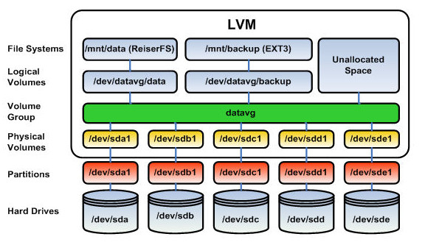
Logical Volume Manager (LVM)
Advantages:
It provides data redundancy
Performance of Volume Manager is high
Possible to extend size of file system and to reduce F.S
Cont….

Slide 35
Logical Volume Manager (LVM)
Cont…
Physical Volume (PV):
* It is nothing other than giving a Physical Volume ID to the partition
Volume Group (VG):
Collection of 1 or more PV
If a PV is allocated to a VG, the same PV cannot be given to another VG
Logical Volume (LV):
Partition Created from VG, this LV can be used to store data
Attached MS word object below, It has the step by step procedure to create, extend, reduce and remove LVM

Slide 36
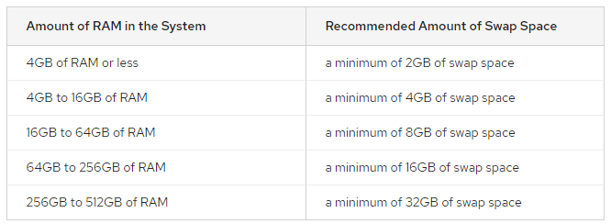
SWAP
The primary function of swap space is to substitute disk space for RAM memory when real RAM fills up and more space is needed.
While swap space can help machines with a small amount of RAM, it should not be considered a replacement for more RAM
Swap space is located on hard drives, which have a slower access time than physical memory
Cont…

Slide 37
SWAP
Cont…
Q. How to Create Swap file?
A. Initially the swap file has to be created while installing the O.S.
Q. How to increase Swap size?
A. Steps in Document attached below

